Slide 2
LNDC Mandate
Established through an ACT of Parliament; LNDC ACT 1967 as amended.
To promote and facilitate investments for:
Sustainable economic development
Domestic economic empowerment
Employment generation

Slide 3
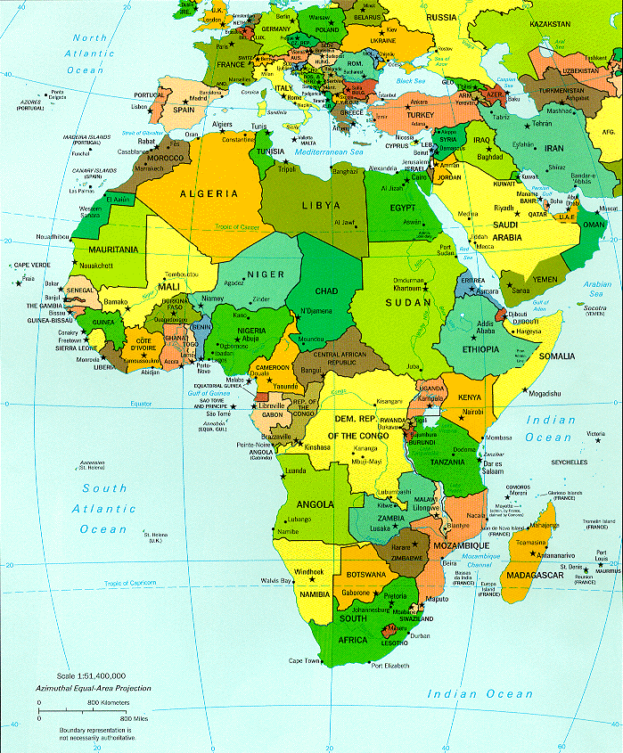
Lesotho’s Key Attributes
Location: | Southern Africa
Capital: | Maseru
Size: | 30 335Km²
Population: | 1.9million
Population growth rate: | 0.9%
Language: | English , Sesotho
Climate: | temperate
Politics: | Multi-party democracy
Economy: | WTO member, MIGA
Altitude : | 3400m (Highest point) 1400m (Lowest point)

Slide 4
Key Economic Indicators(2012/3)
GDP = USD 1.9billion
GDP Growth = 6.5%
Inflation = 5%
Exports = 56% of GDP

Slide 5
Key Economic Indicators (Inflation trend)
Inflation (2013) : 5%
Exit

Slide 6
Direction of Exports
% to total exports in 2013
TOTAL EXPORTS: | US$1,056 million
SACU | 35.6%
USA | 34.5%
EU | 27.8%
REST OF THE WORLD | 2.1%
Source: Central Bank of Lesotho(2013)
Exit

Slide 7
Overview of Investment Opportunities
Agriculture and Agro-Processing
Textiles and Garments
Automotive Components
Construction
ICT Services
Mining

Slide 8
Why Invest in Lesotho
Proven Track Record
Largest Exporter Garments to the US Market
Exported over US$ 360 million worth of garments to the US in 2013
Home to some of best known international and regional Brands:
Jonsson Workwear
Crabtree
GAP
Levi
General Motors

Slide 9
Why Invest in Lesotho
Ease of doing business
One stop business facilitation
LNDC investment services
Investment climate reforms
Ranked 79 on starting business
Moved 17 places from 153 in 2012 to 136 in 2013 on general investment reforms.

Slide 10
Why Invest in Lesotho
Tax Incentives
10% corporate tax rate for manufacturing entities
Corporate tax for other commercial entities is 25%
No withholding tax on dividends distributed by manufacturing operations
Training costs allowable at 125% for tax purposes

Slide 11
Why invest in Lesotho
Cost of doing business (Loti = 10USD)
Wages
-General minimum wage M1500
-Construction M1679 to M2946
-Retail M1456 to M1549
Utilities
-Electricity: Demand (kWh) M192.27470
Energy (kWh) M0.1724
-Water: M9.08 per 1000litres
Permits
-Work permit = M2000
-Residence permit = M3,500

Slide 12
Why invest in Lesotho
Market Access
Southern African Customs Union (SACU)
(5 countries comprising 55 million consumers)
Southern African Development Community (SADC)
(14 countries comprising 260 million consumers)
Duty free and concessionary access of Lesotho made products to:
USA (310 million people)
EU (490 million people)
Mercursor (South America) (385 million people)
(Argentina, Brazil, Paraguay, Uruguay)
GSP: Japan (127 million people),Canada (34 million people),Australia (22 million people), Turkey(72 million) and SACU EFTA

Slide 13
LNDC- Investment Facilitation
Assistance with company registration
Procurement of permits and licenses
Provision of serviced industrial and commercial buildings
Provision of serviced industrial and commercial sites
Promotion of good industrial relations
Facilitation of access to finance for joint ventures

Slide 14
Thank You Invest, Live and Prosper
CONTACT: info@lndc.org.ls
PHONE: +266 22312012

